Slide 1
Tensorflow basics – part 2
Prof. Yong Won SEO, Ph.D.
College of Business and Economics
Chung-Ang University

Slide 2
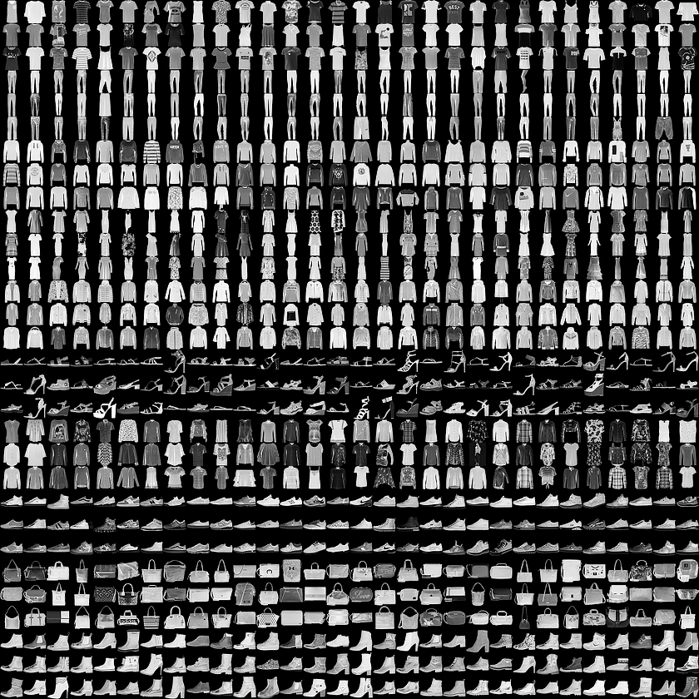

Slide 3
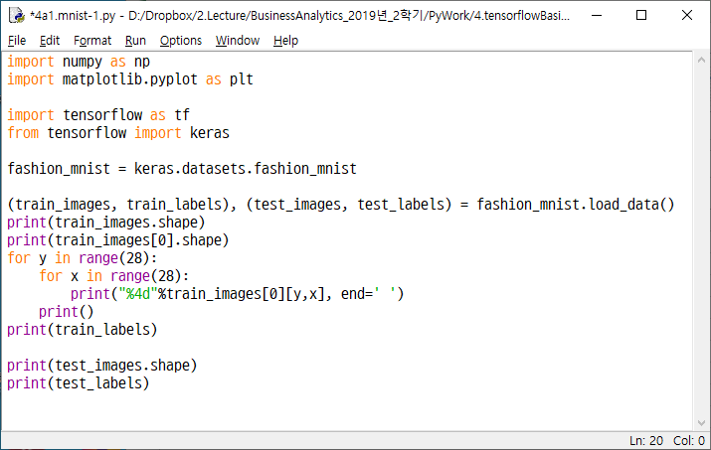

Slide 4
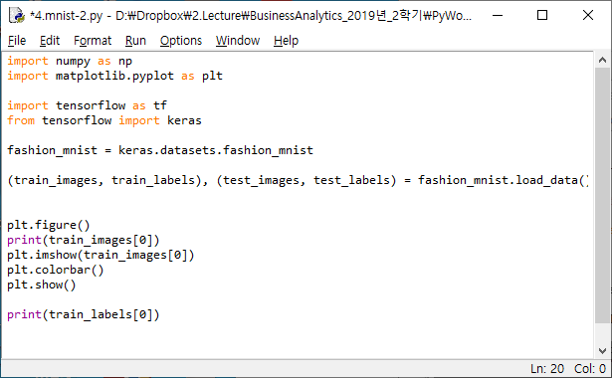

Slide 5
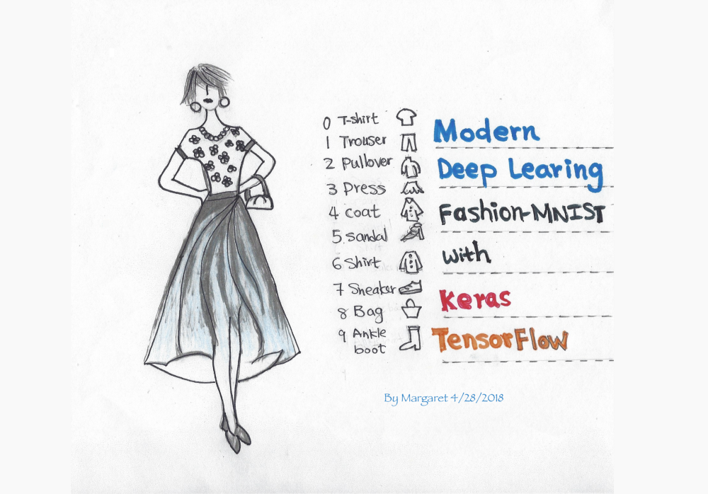

Slide 6
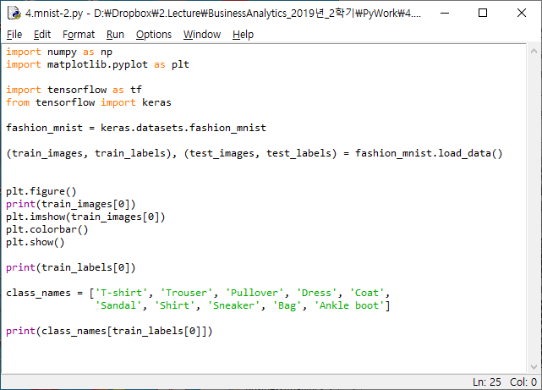

Slide 7
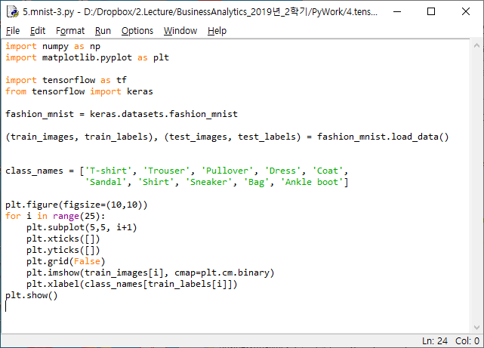

Slide 8
1
2
1
3
1
2
4
2
3
5
3
4
6
…
5
7
10
…
8
128
9
…
784

Slide 9
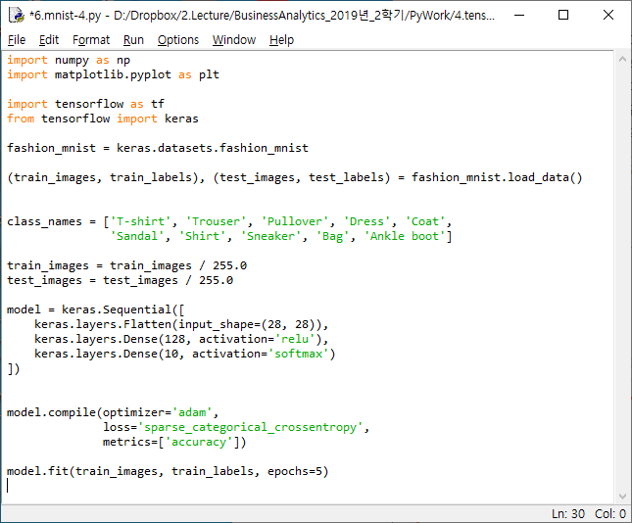

Slide 10
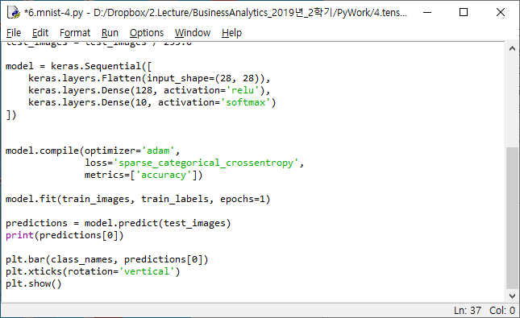

Slide 11
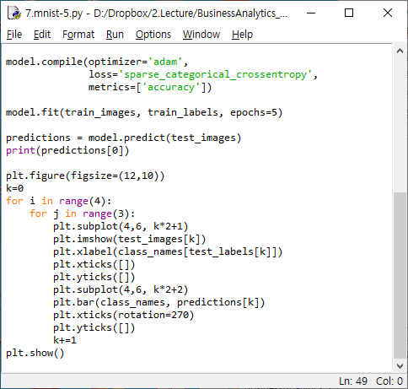

Slide 12
